Slide 1
AGIFORS Annual Symposium 2026
Rethinking the embedded OR team as a specialized software team
Francisco Zenteno Smith
Senior Operations Research Scientist
American Airlines
Every comment here represents my own opinion, and does not represent an American Airlines statement
Notes:
Hook: what is an OR team building?

Slide 2
Working in a project v/s building a product
Operations Research (OR) turns data + business needs + mathematics → decision.
A project delivers a one-time decision.
A product delivers a recurring decision (and someone must own it).
Examples:
Plan the annual fleet composition
Generate the monthly crew schedules
Recover from irregular operations
These products are also known as
decision-support systems (DSS)
Its business value comes from being sustainable over the lifetime of the business need.
Notes:
Hook: sustainability is a software property, how good is it in DSS?

Slide 3
DSS often has weak software practices surrounding the applied mathematics
Decision-support system
Cultural reasons
Scientists are trained deeply in mathematics, but not in software engineering (SE).
They don’t know the benefits of SE, or they don’t think it is for them.
Technical reasons
DSS has unique challenges deriving from the mixture of applied mathematics and SE.
Software components
  How to automatically test an optimization model?
  How to design the system to be solver-agnostic?
  How to set an experimentation platform?
Applied mathematics
Source: Vidoni, Cunico & Vecchietti (2018, 2020); Vidoni (2021); Vidoni & Cunico (2022); Kanewala & Bieman (2014)
Notes:
Some cracks: using jupyter notebooks; lack of automatic tests.
Hook: what is the price we pay because of these weak practices?

Slide 4
Weak software practices constrain the potential business value a DSS can deliver
What happens to weak software?
Harder to test, deploy and maintain.
Short-term delivery includes significant technical debt.
At some point becomes unsustainable: rewrite or decommission.
Total progress
Solid foundations
Legacy system
Short-lived system
Time
Source: A Philosophy of Software Design (John Ousterhout). These curves are illustrative.
Notes:
Short-lived system: soon (maybe 1 year?) progress stalls as it can't support changes efficiently.
Legacy system: started fine; after a couple of years the initial developers left. Now it is unclear how it works, or making a change is very difficult.
Hook: so how strengthen the weak practices?

Slide 5
Operate as a specialized software development team to unlock the full value of a DSS
Developers to tackle problems unrelated to OR: design a database, data, deployments.
Software
Engineering
OR Engineers to set scientific development needs: optimization model testing, solver-agnostic design, experimentation suite, among others.
Operations
Research
Scientists trained in some SE elements: SDLC, elicitation, agile, OOP, basics of design, automated testing, TDD, CI.
Notes:
The obvious fix? to hire developers, but that does not work.
OR should not know everything about SE, just what it needs.
OR engineers help scientists develop properly
Hook: then my science team will grow 10x? What is the actual scope I need?

Slide 6
The OR team owns the product, but it does not need to hold every skill itself
OWN
BORROW
Business interaction
Product behavior
Software quality
CI/CD
Cybersecurity
Infrastructure
Reliability expertise
UI/UX
Borrow expertise from your organization. Keep product ownership.
Notes:
Hook:
Ok what happens now when we train scientists in software engineering?

Slide 7
Case study: strengthening the engineering of a DSS improved throughput and quality
15-month case study · 4 OR scientists · from pilot → DSS
Before
After
15 months transformation
Throughput
Throughput
1x
2.3x
+130%
Software quality
Heavy training of SE to OR scientists
Refactoring the system for OR needs
Software quality
✕
✓
Low test coverage
Code smells unattended
+42pp in test coverage
2/3 reduction in code smells
Notes:
Every team walks this leg first, whatever it decides to staff afterwards.
Hook: 15 months of engineering. why bother, when AI writes the code?

Slide 8
AI-coding assistants require the engineering investment urgently: they amplify your practices
Strong engineering practices
AI
↗ Sustainable acceleration
×
=
Faster delivery + higher quality
Automated testing
CI/CD
Architecture
Weak engineering practices
AI
↘ Accelerated technical debt
×
=
More output + more risk
Manual testing
(or absence)
Manual processes
Unclear design
Source: DORA Research 2025 – State of AI-assisted Software Development (Google Cloud, 2025)
Notes:
Hook: AI multiplies what you already have. So what does your team already have?

Slide 9
A reflection: what could you improve in your team structure and practices?
Developers to tackle problems unrelated to OR: design a database, data, deployments.
Software
Engineering
OR Engineers to set scientific development needs: optimization model testing, solver-agnostic design, experimentation suite, among others.
Operations
Research
Scientists trained in some SE elements: SDLC, elicitation, agile, OOP, basics of design, automated testing, TDD, CI.
Notes:
Pause here. This is the only moment in the talk that is about their team rather than about OR teams in general.
Hook: if you identified a gap in OR Engineers or Scientists training…. How to close that gap?

Slide 10
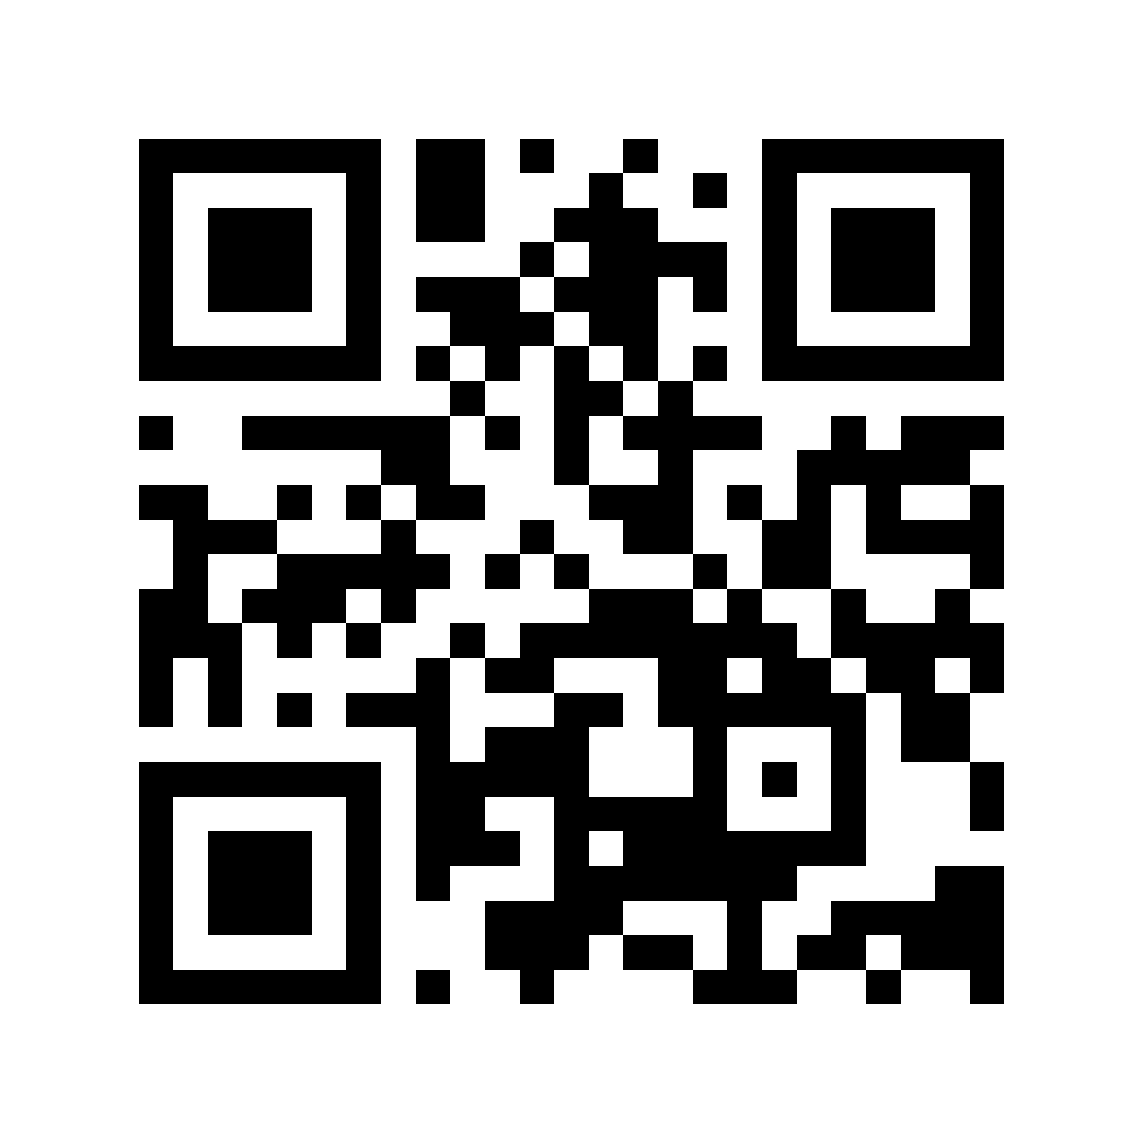
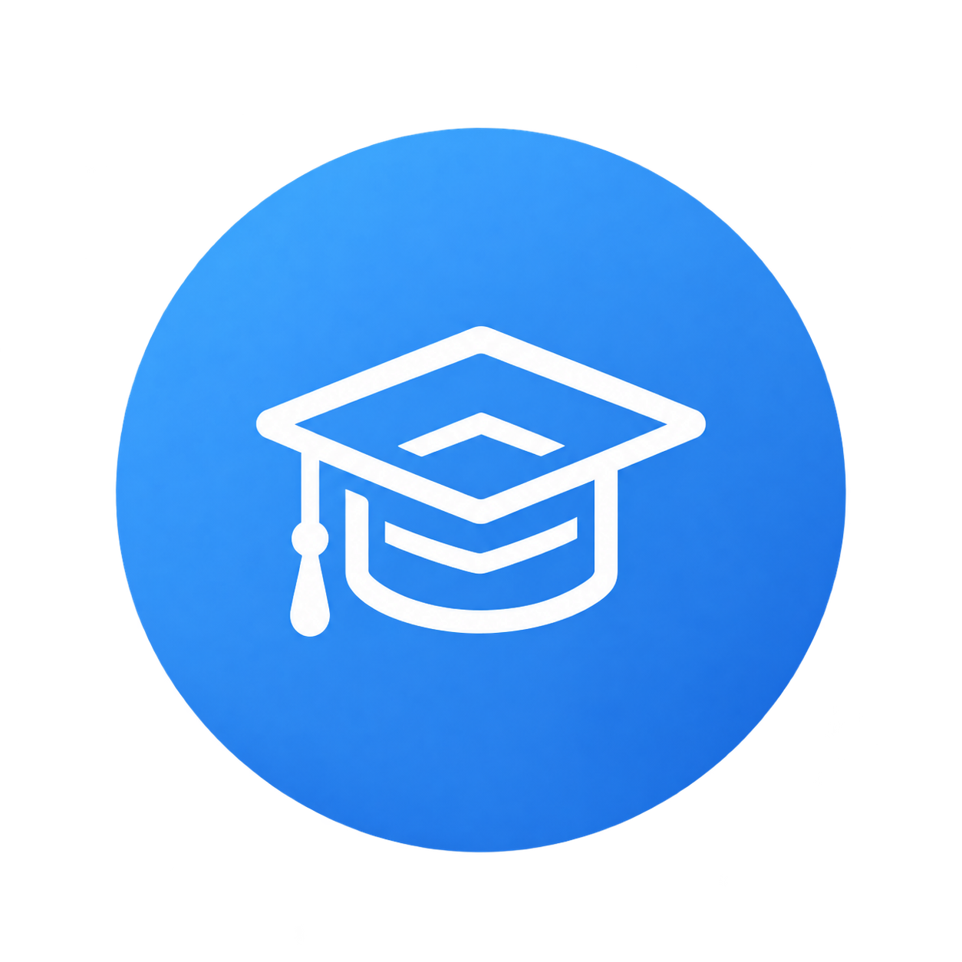
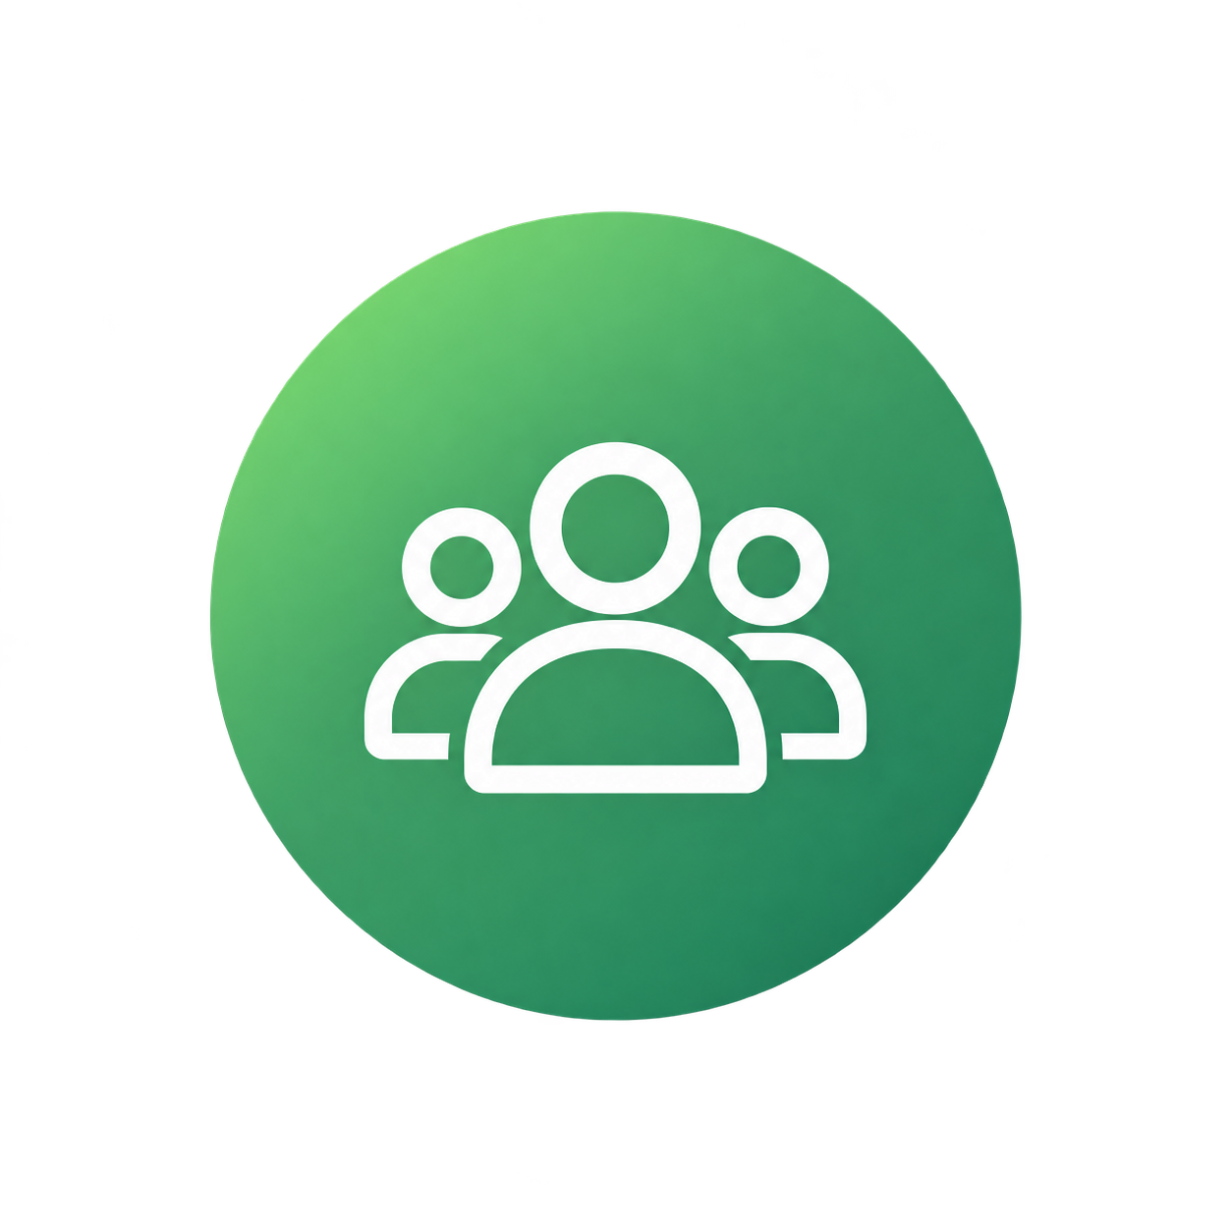
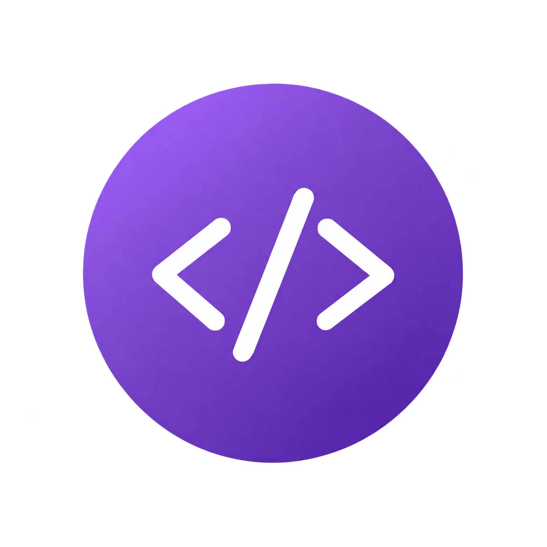
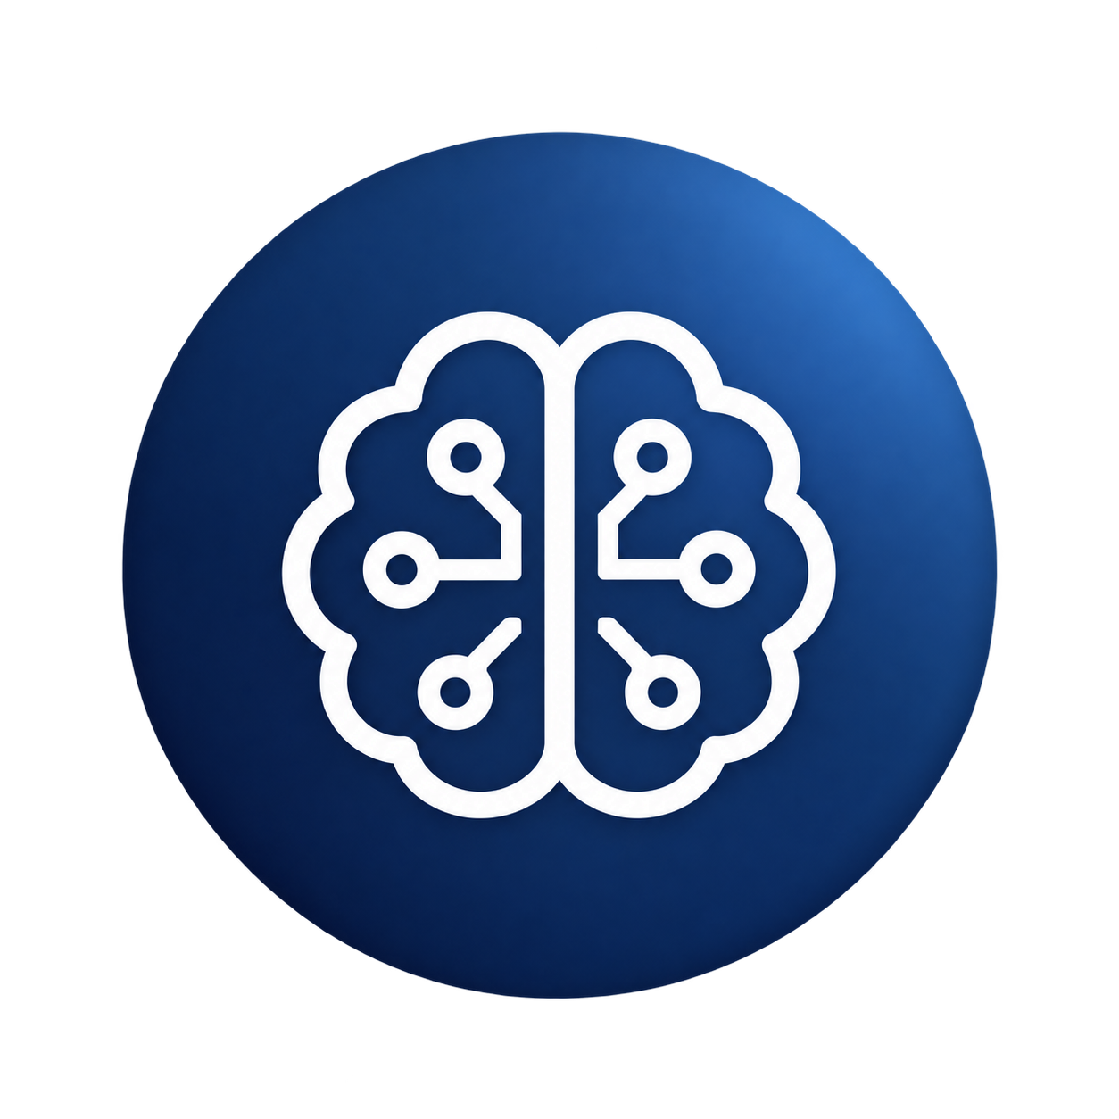
How do you build that team? SEFOP packages practices and training materials
Software Engineering Framework for Optimization Programs — free & open-source
Train
Lead
Deliver
Go agentic
github.com/sefop
Notes:
SEFOP exists so OR teams do not have to rediscover these practices independently.

Slide 11
Conclusions
1
A recurring decision is a product. Product is software.
2
Software needs proper engineering practices to unlock its full business value.
3
The OR team has to own the lifecycle of the product, with its specific software & scientific needs.
4
AI-coding assistants need proper engineering first to unlock full potential.

